Slide 1


Divorce and Occupation
VODCAST ASSIGNMENT 1
-Varun Ramesh (s3797675)

Slide 2
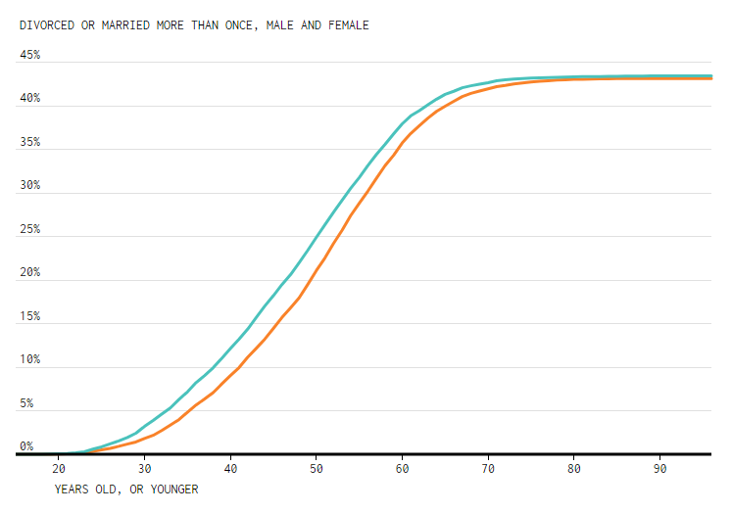
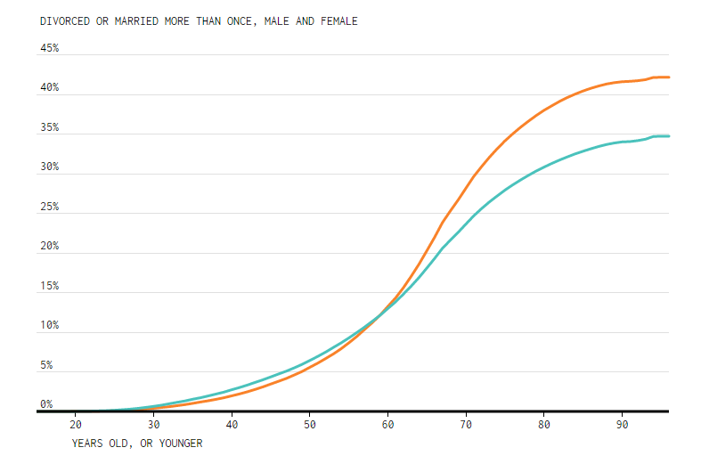
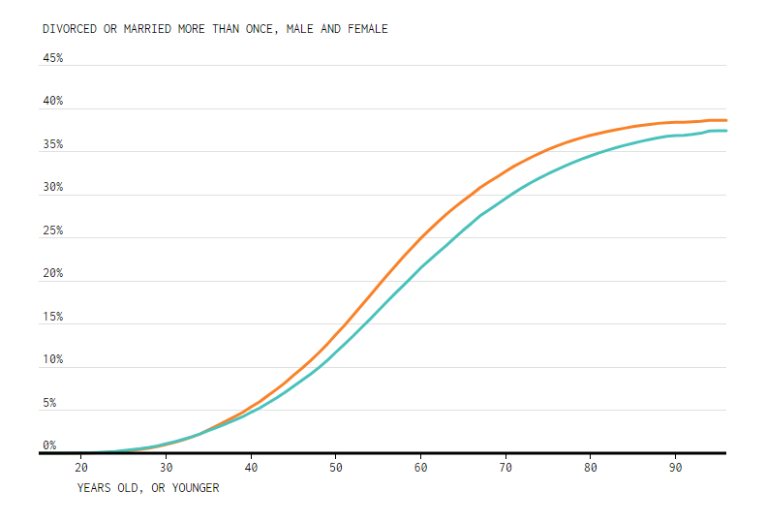
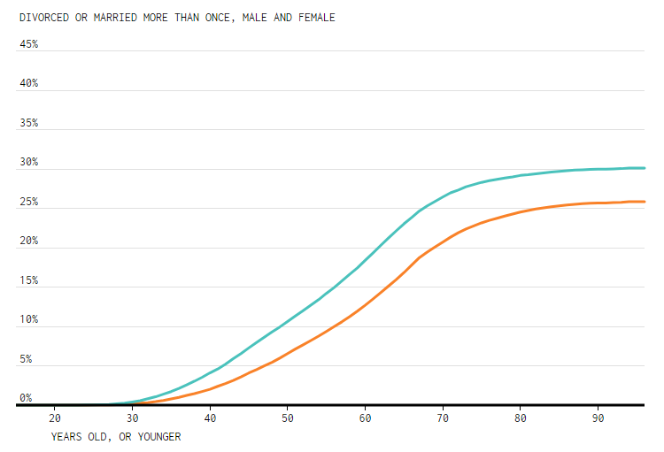

Unemployed
Employed and not in Labor Force
Male
Female
High School Education
Graduate

Slide 3
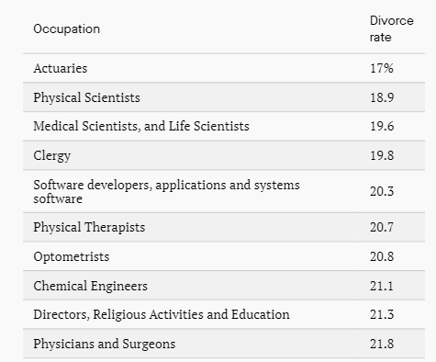
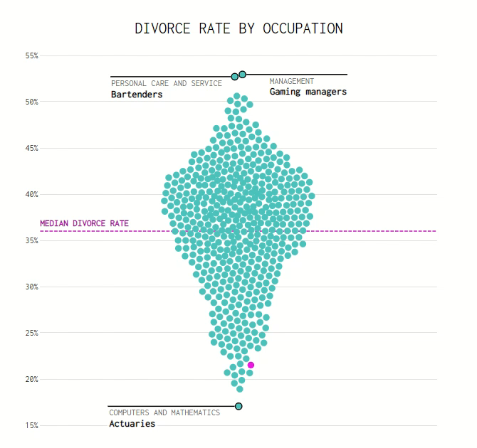
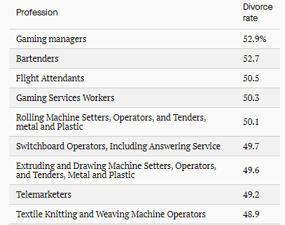
10 Occupations with lowest divorce rate
10 Occupations with highest divorce rate

Slide 4
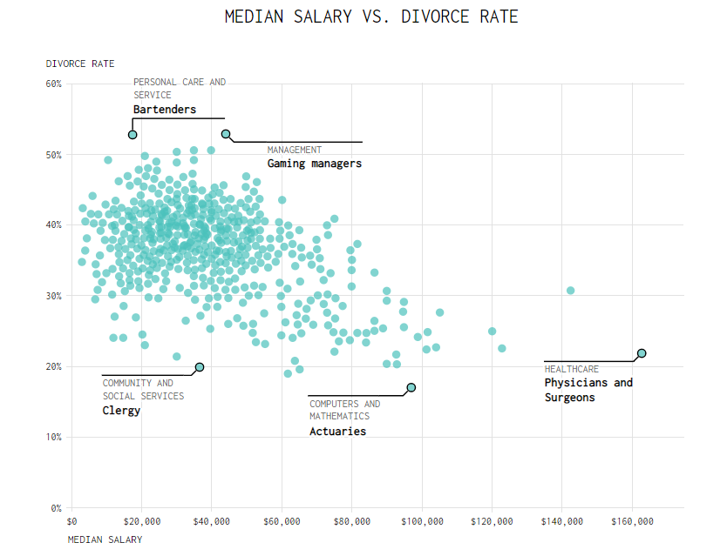
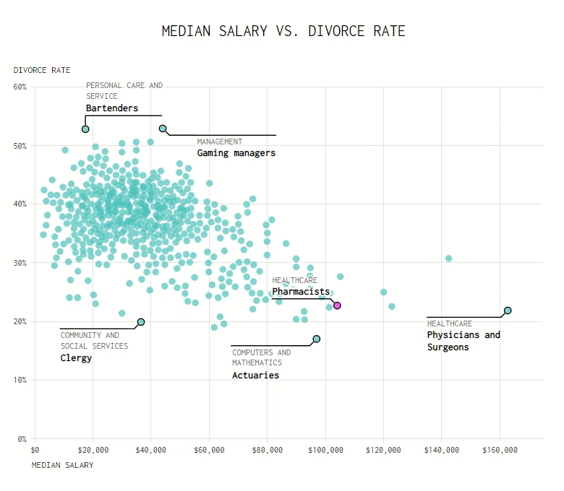

Slide 5
Happily Ever After?

